Slide 1
NUMERICAL DIFFERENTIATION
CHAPTER 4

Slide 2
INTRODUCTION
Numerical differentiation is the process of finding the numerical value of a derivative of a given function at a given point. In general, numerical differentiation is more difficult than numerical integration.

Slide 3
Numerical differentiation involves the computation of a derivative of a function f from given values of f. Such formulas are basic to the numerical solution of differential equations.
Defining fj′=f′(xj),fj″=f″(xj), where f′(x)=limh→0⁡f(x+h)−f(x)h, one obtains the relations
f1/2′≈δf1/2h=f1−f0h
and
f1″≈δ2f1h2=f2−2f1+f0h2.
More accurate approximations can be obtained by differentiating suitable Lagrange interpolation polynomials. For example, given the Lagrange interpolation polynomial as before,
p2(x)=(x−x1)(x−x2)2h2f0−(x−x0)(x−x2)h2f1+(x−x0)(x−x1)2h2f2,
where x1−x0=x2−x1=h, one obtains
f′(x)≃p2′(x)=2x−x1−x22h2f0−2x−x0−x2h2f1+2x−x0−x12h2f2.

Slide 4
Evaluating this expression at the points x0,x1,x2 yields the “three-point” formula:
f0′≈12h(−3f0+4f1−f2),f1′≈12h(−f0+f2),f2′≈12h(f0−4f1+3f2).
Similarly, using the Lagrange interpolation polynomial p4(x) yields
f2′≈112h(f0−8f1+8f3−f4).
NUMERICAL DIFFERENTIATION USING NEWTON'S FORWARD DIFFERENCE FORMULA:-

Slide 5
Formula & Example-1 (table data)
Formula
1. For x=x0 [dy/dx]x=x0=1h⋅(ΔY0-12⋅Δ2Y0+13⋅Δ3Y0-14⋅Δ4Y0+...) [d2y/dx2]x=x0=1h2⋅(Δ2Y0-Δ3Y0+1112⋅Δ4Y0+...)
2. For any value of x [dy/dx]=1h⋅(ΔY0+2t-12!⋅Δ2Y0+3t2-6t+23!⋅Δ3Y0+4t3-18t2+22t-64!⋅Δ4Y0+...) [d2y/dx2]=1h2⋅(Δ2Y0+(t-1)⋅Δ3Y0+12t2-36t+2224⋅Δ4Y0+...)

Slide 6
Examples
1. Using Newton's forward/backward differentiation method to find solution
x = 0
x | f(x)
0.0 | 1.0000
0.1 | 0.9975
0.2 | 0.9900
0.3 | 0.9776
0.4 | 0.8604

Slide 7
Solution:
Numerical differentiation method to find solution.
The value of table for X and Y
X | 0 x0=0 | 0.1 x1=0.1 | 0.2 x2=0.2 | 0.3 x3=0.3 | 0.4 x4=0.4
Y | 1 y0=1 | 0.9975 y1=0.9975 | 0.99 y2=0.99 | 0.9776 y3=0.9776 | 0.8604

Slide 8
X | Y(X) | ΔY | Δ2Y | Δ3Y | Δ4Y
0 X0=0 | 1 Y0=1
 |  | -0.0025 -0.0025=0.9975-1 ΔY0=Y1-Y0
0.1 X1=0.1 | 0.9975 Y1=0.9975 |  | -0.005 -0.005=-0.0075--0.0025 Δ2Y0=ΔY1-ΔY0
 |  | -0.0075 -0.0075=0.99-0.9975 ΔY1=Y2-Y1 |  | 0.0001 0.0001=-0.0049--0.005 Δ3Y0=Δ2Y1-Δ2Y0
0.2 X2=0.2 | 0.99 Y2=0.99 |  | -0.0049 -0.0049=-0.0124--0.0075 Δ2Y1=ΔY2-ΔY1 |  | -0.1 -0.1=-0.0999-0.0001 Δ4Y0=Δ3Y1-Δ3Y0
 |  | -0.0124 -0.0124=0.9776-0.99 ΔY2=Y3-Y2 |  | -0.0999 -0.0999=-0.1048--0.0049 Δ3Y1=Δ2Y2-Δ2Y1
0.3 X3=0.3 | 0.9776 Y3=0.9776 |  | -0.1048 -0.1048=-0.1172--0.0124 Δ2Y2=ΔY3-ΔY2
 |  | -0.1172 -0.1172=0.8604-0.9776 ΔY3=Y4-Y3
0.4 X4=0.4 | 0.8604 Y4=0.8604

Slide 9
The value of x at you want to find f(x):x0=0
h=x1-x0=0.1-0=0.1
[dydx]x=x0=1h⋅(ΔY0-12⋅Δ2Y0+13⋅Δ3Y0-14⋅Δ4Y0)
∴[dydx]x=0=10.1⋅(-0.0025-12×-0.005+13×0.0001-14×-0.1)
∴[dydx]x=0=0.25033
d2ydx2]x=x0=1h2⋅(Δ2Y0-Δ3Y0+1112⋅Δ4Y0)
∴[d2ydx2]x=0=10.01⋅(-0.005-0.0001+1112×-0.1)
∴[d2ydx2]x=0=-9.67667
Solution for Pn′(0)=0.25033
Solution for Pn′′(0)=-9.67667

Slide 10
ERROR IN NUMERICAL DIFFERENTIATION
The error in our formula is composed of two parts. The first and easiest to analyze is the theoretical error. The second is caused by roundoff error. Roundoff error comes from representing the numbers x and x + h as floating point numbers.

Slide 11
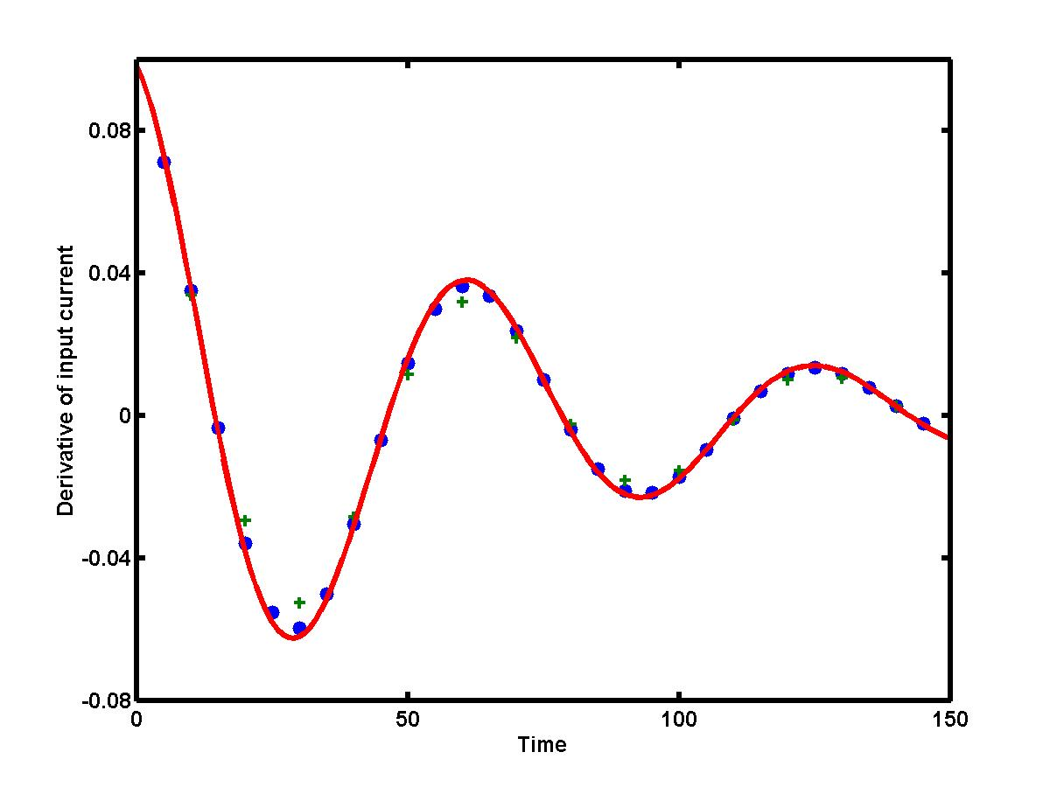
If the step size h between two adjacent values becomes smaller, the truncation error of the difference approximation decays. For example, if the step size is reduced by half, the truncation error of the central difference approximation is reduced by four. Therefore, if we can control the step size for data samples, then the truncation error can be reduced to any digit after the period! The figure below presents two central difference approximations for the derivative of the current I = I(t) (view the data values for the current). The approximations are obtained with step size h = 10 (green pluses) and with step size h = 5 (blue dots), versus the exact derivative I'(t) (red solid curve). The error of central difference approximation clearly reduces with smaller step size h.

Slide 12

However, the numerical approximation for the derivative could be really bad for smaller step sizes h. Indeed, when the step size is small, the central difference is taken for almost equal values I₁ and I₋₁. Due to round-off error, it may lead to catastrophic cancellation and loss of accuracy in numerical computation. The smaller is the step size, the larger is the round-off error!

